Slide 1
C126 Team 6
Predicting the Nasdaq 100
Tan Liang Meng
Hui XuJia
Lim Ricky

Slide 2
Our Motivation
Vast Amount of Data
Data science and Machine Learning techniques to uncover insights.
Financial Market
Practical applications for investors and financial institutions.
Notes:
As a Computer Science & Engineering student, the motivation for predicting the NASDAQ 100 trend lies in the vast amount of data available on financial markets and the potential to apply data science and machine learning techniques to uncover insights and make informed investment decisions.
The NASDAQ 100 is a widely followed index, consisting of 100 of the largest and most actively traded non-financial companies listed on the NASDAQ stock exchange. It represents a diverse range of industries, including technology, healthcare, consumer services, and others.
By predicting the trend of the NASDAQ 100, a student from Computer Science & Engineering can gain valuable experience in data wrangling, data visualization, statistical analysis, and machine learning. The project can also help develop a deeper understanding of financial markets and the factors that influence stock prices.
Furthermore, the ability to predict the trend of the NASDAQ 100 can have practical applications for individual investors and financial institutions. It can provide valuable insights into potential investment opportunities, help optimize portfolio management strategies, and support informed decision-making.

Slide 3
Problem Definition
Which Index is best suited for Prediction?
Stable and consistent performance.
Bankruptcy
Waves of Bankruptcy were filed this March in the financial sector.

Slide 4

5 Year Period
Nasdaq
Jan 2018
Mar 2023

Slide 5
Exploratory Data Analysis
01

Slide 6
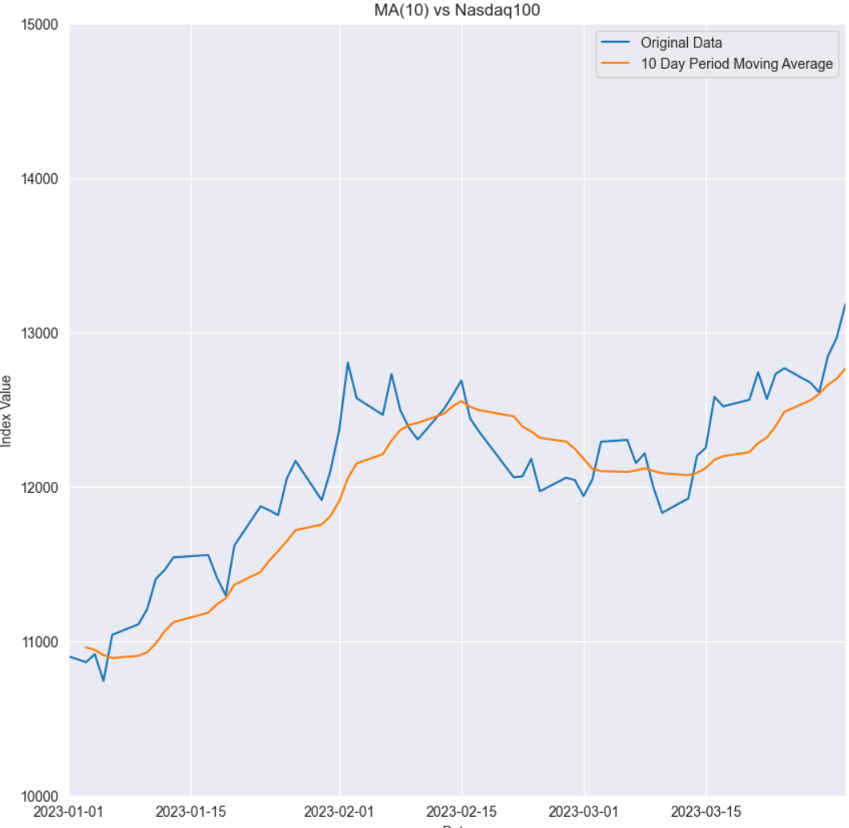
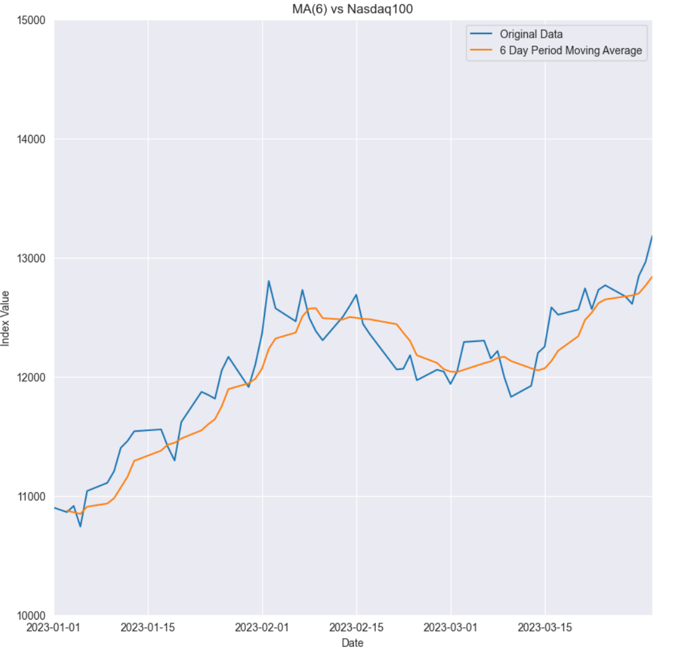
Moving Average Trend
10 Days Average
6 Days Average

Slide 7
Moving Average Trend
*Lower the value the better

Slide 8
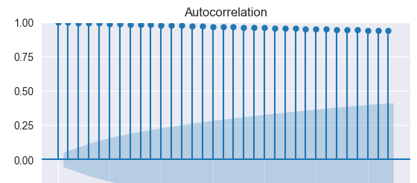
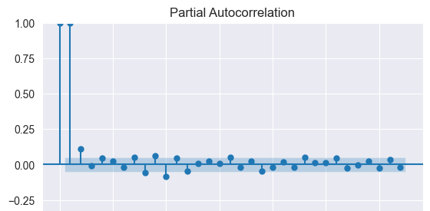
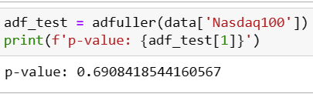
Stationarity of the Time series
NOT STATIONARY
Notes:
The time series data exhibits high and positive autocorrelation with a slow decay in the ACF plot and spikes in the PACF plot, indicating significant partial autocorrelation at certain lags. The ADF test result of 0.69 suggests that the time series may be non-stationary, which can make analysis and prediction difficult. Transformations of the data is needed to make the time series stationary before further analysis can be done.

Slide 9
Data Prep & Cleaning
02

Slide 10
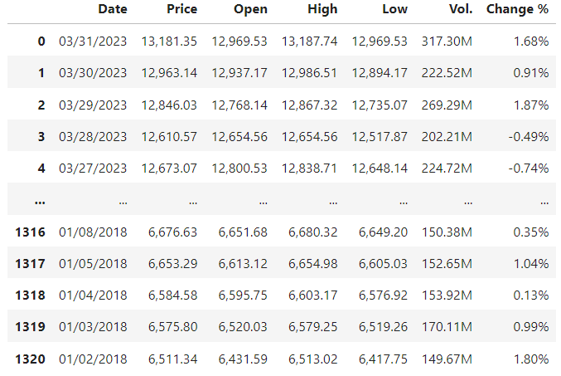
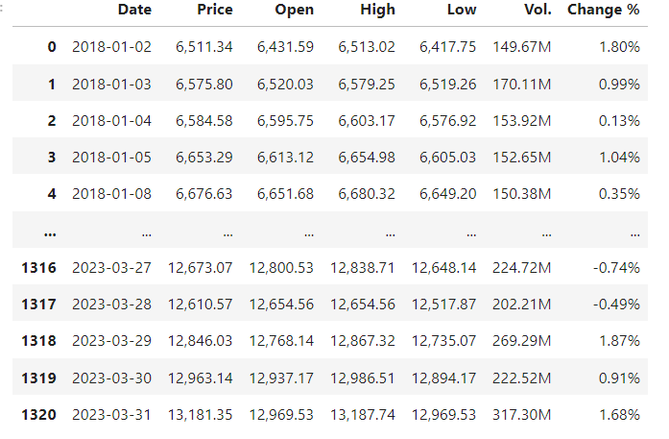
Sorting by Date
Notes:
The time series data exhibits high and positive autocorrelation with a slow decay in the ACF plot and spikes in the PACF plot, indicating significant partial autocorrelation at certain lags. The ADF test result of 0.69 suggests that the time series may be non-stationary, which can make analysis and prediction difficult. Transformations of the data is needed to make the time series stationary before further analysis can be done.

Slide 11
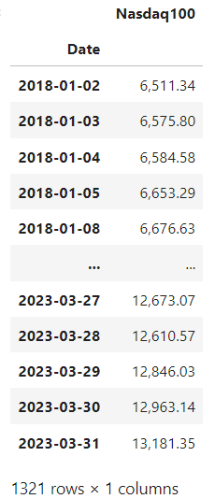
Dropping Columns
Notes:
The time series data exhibits high and positive autocorrelation with a slow decay in the ACF plot and spikes in the PACF plot, indicating significant partial autocorrelation at certain lags. The ADF test result of 0.69 suggests that the time series may be non-stationary, which can make analysis and prediction difficult. Transformations of the data is needed to make the time series stationary before further analysis can be done.

Slide 12

Train and Test Set
Notes:
The time series data exhibits high and positive autocorrelation with a slow decay in the ACF plot and spikes in the PACF plot, indicating significant partial autocorrelation at certain lags. The ADF test result of 0.69 suggests that the time series may be non-stationary, which can make analysis and prediction difficult. Transformations of the data is needed to make the time series stationary before further analysis can be done.

Slide 13
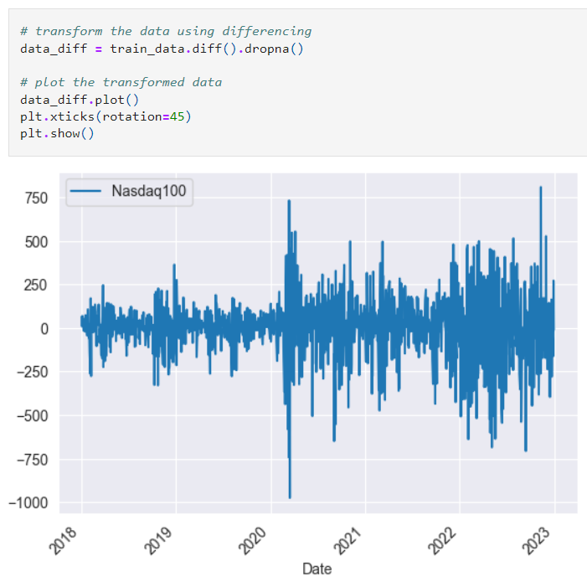
Data Transformation
Notes:
The time series data exhibits high and positive autocorrelation with a slow decay in the ACF plot and spikes in the PACF plot, indicating significant partial autocorrelation at certain lags. The ADF test result of 0.69 suggests that the time series may be non-stationary, which can make analysis and prediction difficult. Transformations of the data is needed to make the time series stationary before further analysis can be done.

Slide 14
Machine Learning
03

Slide 15
What is an ARIMA model?
Autoregressive Integrated Moving Average
Auto Regression (AR)
ARIMA
Integration (I)
Moving Average(MA)
Notes:
The model that we first choose to forecast the Nasdaq100 timeseries is
ARIMA (Autoregressive Integrated Moving Average) is a popular statistical model used for time series forecasting. It is a combination of three components: Autoregression (AR), Integration (I), and Moving Average (MA).
The AR component models the relationship between the current observation and a lagged observation(s) in the time series. The I component deals with the non-stationarity of the time series and aims to transform the time series into a stationary one through differencing. The MA component models the relationship between the current observation and the residual errors of the past observations. ARIMA models can handle a wide range of time series data, including non-stationary data. They are widely used in finance, economics, and other fields to forecast stock prices, sales, and other time series data.

Slide 16



Why do we choose ARIMA?
Improved forecasting accuracy
Flexibility
Understanding underlying Process
Notes:
We chose to use ARIMA for forecasting our time series data due to its several benefits. Firstly, ARIMA models can significantly improve forecasting accuracy, especially when dealing with non-stationary time series data that can be made stationary through differencing. This helps to better capture the patterns and trends in the data, resulting in more accurate predictions.
Secondly, ARIMA models are highly flexible and can be applied to a wide range of time series data, including non-stationary data. This makes ARIMA a popular choice for many applications in various fields.
Finally, the ARIMA parameters can provide insights into the underlying processes that drive the time series behavior. By analyzing these parameters, we can gain a better understanding of the factors contributing to changes in the Nasdaq100 index

Slide 17
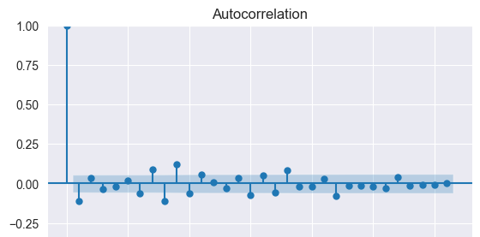
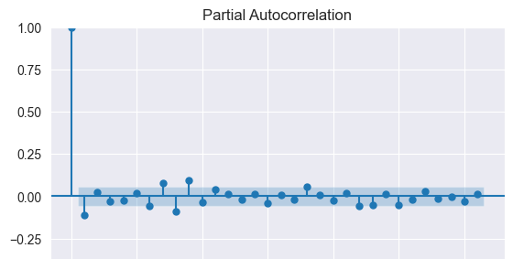
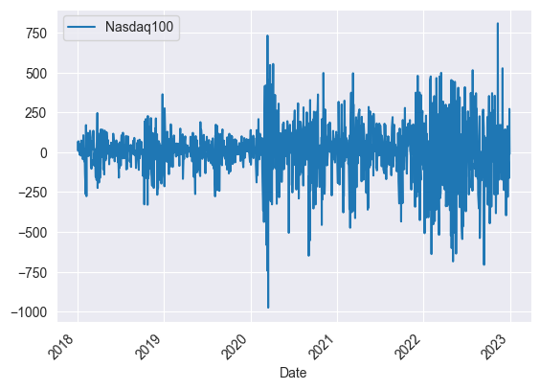
Choosing Parameters
First-order differenced time series
(p,d,q) = (1,1,1)
Notes:
To build the ARIMA model, we analyzed the ACF and PACF plots of our first order differenced data to determine the appropriate parameters. The ACF plot showed a significant spike at the first lag, indicating that an autoregressive (AR) model may be appropriate. The PACF plot also showed significant spikes at the first lag, suggesting that a moving average (MA) component may be needed. We also confirmed that the data became stationary after applying first-order differencing (d=1), indicating that an integrated (I) component is needed in the model. Based on this information, we decided to try a model with p=1, d=1, and q=1.

Slide 18
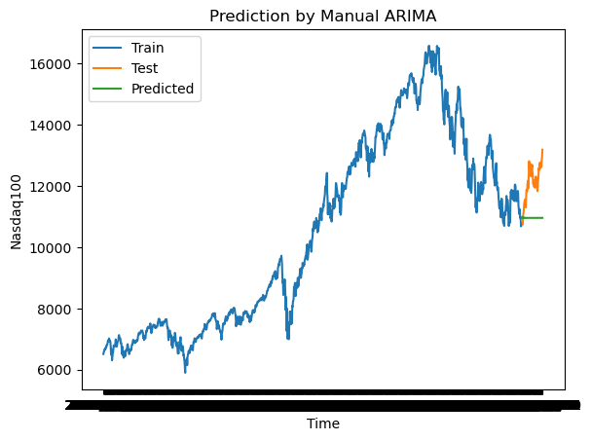
Notes:
After building and fitting our initial ARIMA model, we used it to forecast the test set. We found that the model was able to capture the general range of the values but was unable to capture the complex non-linear trend in the data.

Slide 19

Notes:
To address this issue, we used Auto ARIMA, a statistical algorithm that automatically selects the optimal combination of (p, d, q) parameters for an ARIMA model based on the time series data. It turns out that the result of the AUTO arima is quite similar to the manual arima that we built before.

Slide 20

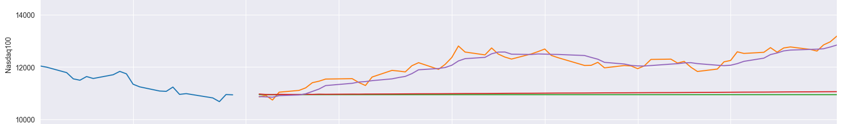
Evaluation of result
Able to capture the general range
Trend was not accurately captured
Notes:
We compared the results of both our manual and auto ARIMA models to the original test set by plotting them together on a graph along with the original data, we found that while both models were able to capture the general range of the actual values, they were unable to accurately capture the complex non-linear trend. This indicates that we may need to explore other modeling techniques, such as recurrent neural networks like LSTM, to better capture the underlying trends present in the data. LSTM models are specifically designed to model patterns in time series data and may be better suited to capturing the complex, non-linear trends present in our dataset.

Slide 21
LSTM
Introduction
Data prep for the model
model -building
Evaluation and Conclusion

Slide 22
What is LSTM?
Introduction
Data prep for the model
model -building
Evaluation and Conclusion
Long Short-Term Memory is a type of recurrent neural network (RNN).
Ability to handle long-term dependencies
Our dataset is 5 years
Selective memory
Ignore irrelevant information
Robust to noise
Better performance

Slide 23
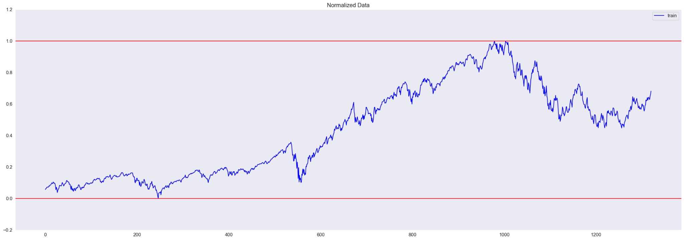
Normalize the Data
Introduction
Data prep for the model
model -building
Evaluation and Conclusion
Help the model converge faster during training
Using MinMaxScale to convert the features into the range of (0,1)
1.0
0

Slide 24
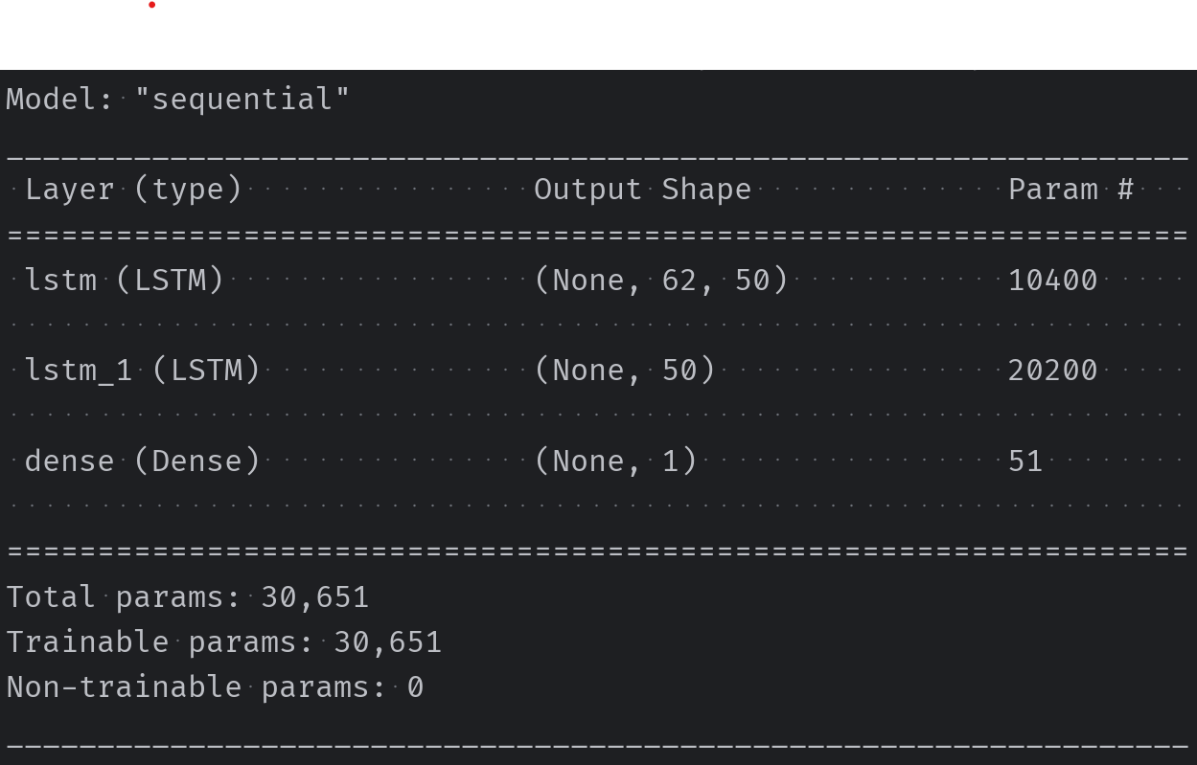
Build the Model
2-Layer, with timestep of 62.
Introduction
Data prep for the model
model -building
Evaluation and Conclusion

Slide 25
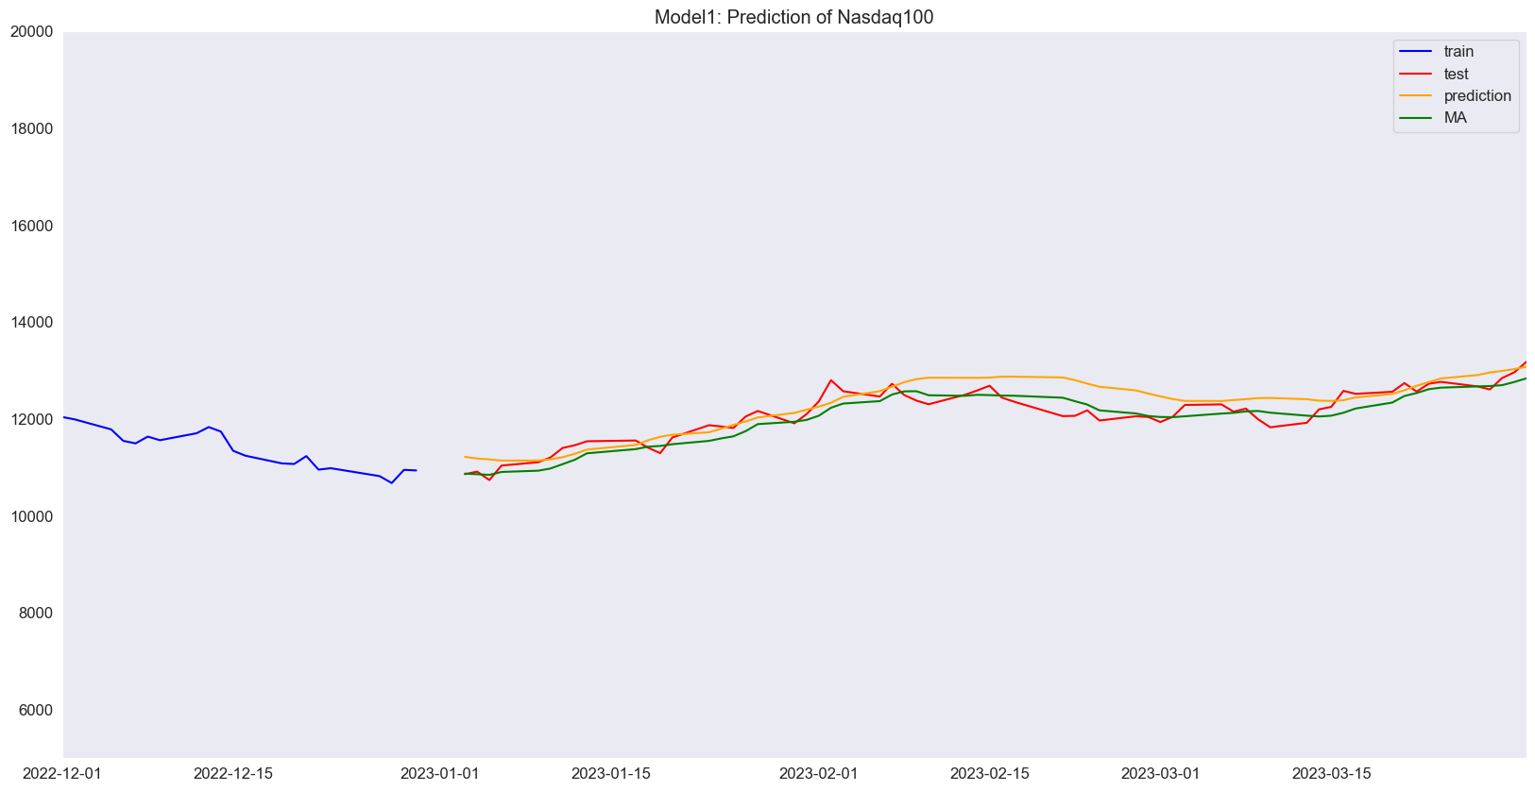
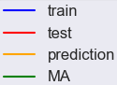
The Result
Introduction
Data prep for the model
model -building
Evaluation and Conclusion

Slide 26
Evaluation & Conclusion
Compare with Original Data
MAE: 253.91753528225817
MAPE: 0.021069321412856504
RMSE: 321.27460731271145
Spearman's Rank Correlation between moving_avg
RHO: 0.950290851401375
p: 4.2512904109518616e-32
Introduction
Data prep for the model
model -building
Evaluation and Conclusion
Relatively small Errors
High rho with very small p-value
Conclusion: the LSTM model can predict the price and trend in the next 62 days of Nasdaq100 with a certain degree of accuracy.

Slide 27
Conclusion
04

Slide 28
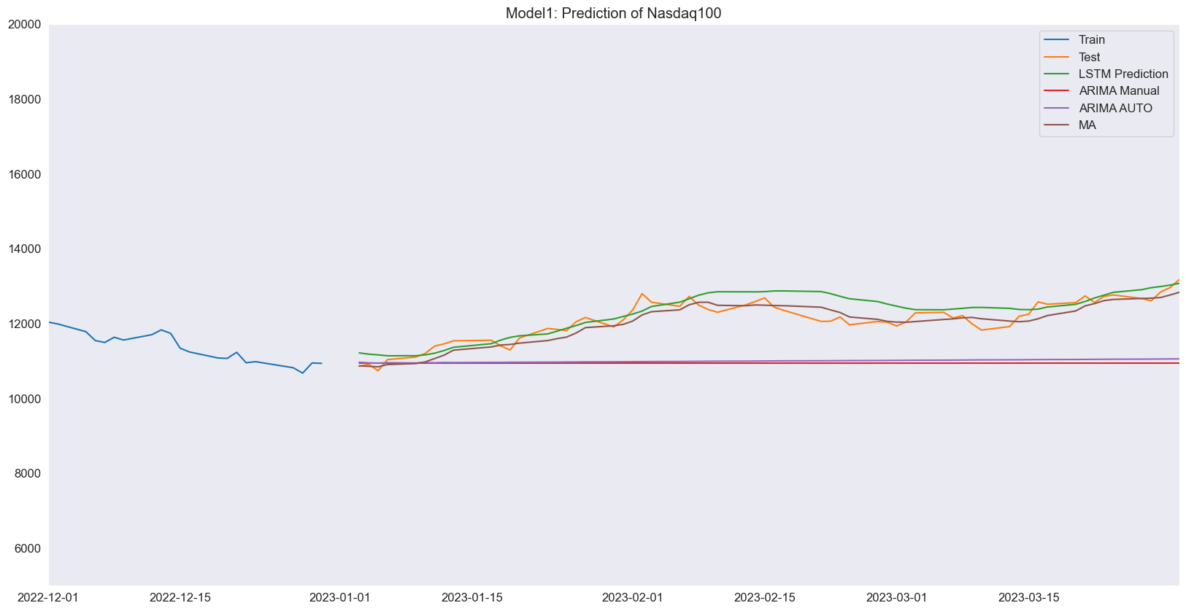
Conclusion

Slide 29
Outcomes
Data Cleaning and Preprocessing
Understanding of Time Series Analysis
Selecting and Using AI Models to solve Real-world Problem
Teamwork and Communication

Slide 30
Data Driven Insights
Analyzing historical price data using sophisticated AI models, it is possible to identify patterns and make predictions about future market movements.
Market trends are influenced by a variety of factors. So it is important to note that market predictions are never 100% accurate, and there is always risks involved in financial decision making.

Slide 31
References
https://analyticsindiamag.com/quick-way-to-find-p-d-and-q-values-for-arima/
https://towardsdatascience.com/machine-learning-part-19-time-series-and-autoregressive-integrated-moving-average-model-arima-c1005347b0d7
https://zhuanlan.zhihu.com/p/266994943
https://thinkingneuron.com/predicting-stock-prices-using-deep-learning-lstm-model-in-python/
https://keras.io/api/layers/recurrent_layers/lstm/#lstm-class
https://scikit-learn.org/stable/modules/generated/sklearn.preprocessing.MinMaxScaler.html

Slide 32
Thank You

